Slide 1
PLANT LEAF DISEASE DETECTION
USING CNN
(MobileNetV2)

Slide 2
INTRODUCTION
1
Objective: Detect and classify diseases in plant leaves using MobileNetV2.
Classes include various diseases such as:
- Bacterial Spot, Early Blight, Late Blight, Leaf Mold, Healthy,
etc.
MobileNetV2 is used for its efficiency and suitability for mobile deployment.

Slide 3
DATASET PREPARATION
2
Dataset organized with class-wise image folders. Images resized to 224x224 pixels.
Preprocessing includes normalization suitable for MobileNetV2.
Labels encoded to categorical format.

Slide 4
3
DATA SPLITTING
Dataset split as follows:
70% Training
15% Validation
15% Testing
Stratified sampling maintains class distribution. Preprocessed using MobileNetV2 input standards.

Slide 5
DATA AUGMENTATION
4
Applied to training images to improve model generalization:
-Rotation, Width/Height Shift, Zoom, Flip, Brightness Adjustments
Implemented using Keras ImageDataGenerator.

Slide 6
MODEL ARCHITECTURE
5
1
Base Model: MobileNetV2 with ImageNet pretrained weights.
Added layers:
GlobalAveragePooling2D
Dense Layer with Softmax Activation
2
3
Initial training with frozen base; fine-tuning last 30 layers.

Slide 7


TRAINING STRATEGY
6
Phase 1: Train with base model frozen (10 epochs). Phase 2: Fine-tune last 30 layers of MobileNetV2 (10 epochs).
Optimizer: Adam with different learning rates for each phase

Slide 8
EVALUATION & METRICS
7
Achieved test accuracy: ~97% Evaluation includes:
Accuracy & Loss
Confusion Matrix
Classification Report Model saved for future use.
97%

Slide 9
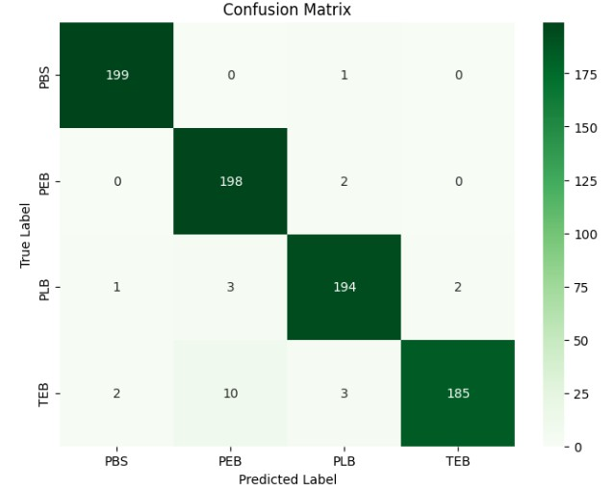
8
PREDICTIONS & VISUALIZATION
Test set predictions visualized with images. Displayed true and predicted labels with confidence.
Graphs:
Accuracy vs. Epochs
Loss vs. Epochs
Confusion Matrix.

Slide 10
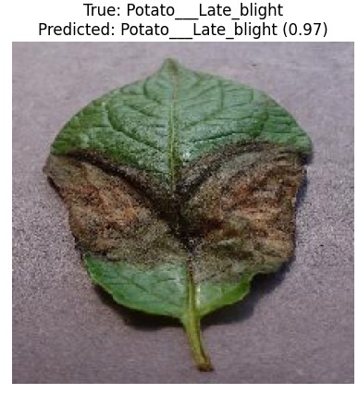
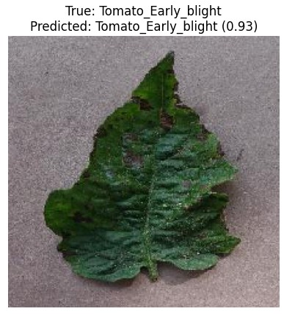
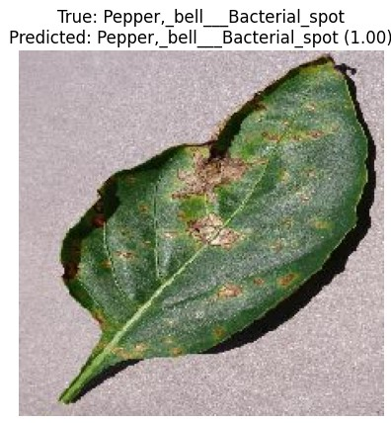
PREDICTIONS & VISUALIZATION
8

Slide 11
CONCLUSION
9
MobileNetV2 performs well in identifying leaf diseases. Fine-tuning and data augmentation significantly improve performance.
Potential real-time deployment in smart agriculture systems.

Slide 12
THANK YOU

